Slide 1

Image-to-Image Translation with Conditional Adversarial Networks
PixToPix

Slide 2
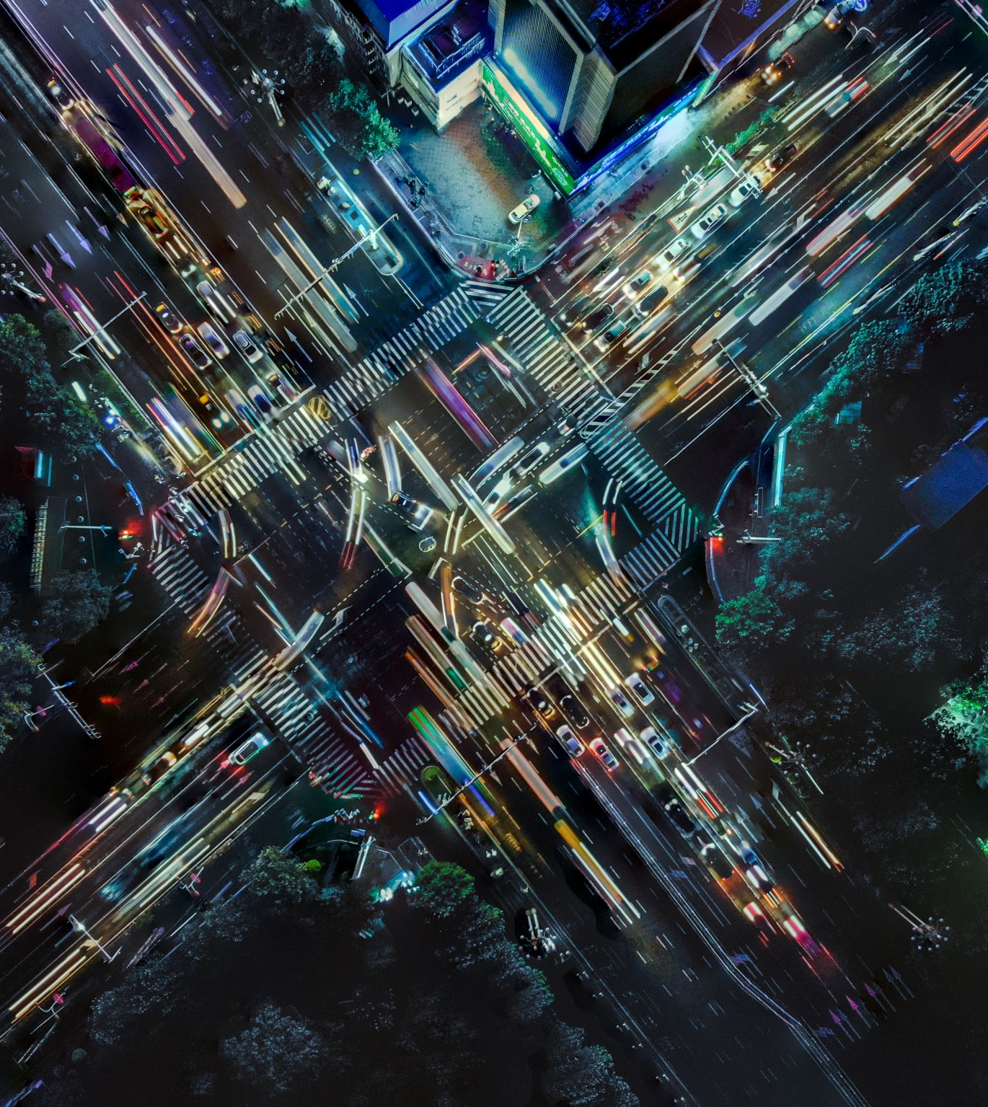
About Pix2Pix
A conditional generative adversarial network (cGAN) that learns a mapping from input images to output images.
2 models that run against each other:
Generator
Discriminator
Applications
converting pixel level segmentation into real images
day images into night images and vice versa
turning Google Maps photos into aerial images
transforming sketches into photos

Slide 3
Generator Arhitecture
Modified U-Net
Encoder (downsampler)
Each block in the encoder: Convolution -> Batch normalization -> Leaky ReLU
Decoder (upsampler).
Each block in the decoder: Transposed convolution -> Batch normalization -> Dropout (applied to the first 3 blocks) -> ReLU
Skip connections between the encoder and decoder (as in the U-Net).

Slide 4
Generator loss function
The generator loss
sigmoid cross-entropy loss of the generated images and an array of ones.
L1 loss- MAE (mean absolute error) between the generated image and the target image.
This allows the generated image to become structurally similar to the target image.
The formula to calculate the total generator loss : gan_loss + LAMBDA * l1_loss, where LAMBDA = 100.
D_fake = disc(x, y_fake)
G_fake_loss = bce(D_fake, torch.ones_like(D_fake))
L1 = l1_loss(y_fake, y) * L1_LAMBDA
G_loss = G_fake_loss + L1
G_loss_mean += G_loss.item() * BATCH_SIZE

Slide 5
Discriminator Arhitecture
Convolutional PatchGAN classifier— tries to determine if an image patch is real or not
Each block in the discriminator: Convolution -> Batch normalization -> Leaky ReLU.
The shape of the output after the last layer: (batch_size, 30, 30, 1)
Each entry in the 30 x 30 image pach classifies a 70 x 70 portion of the initial image

Slide 6
Discriminator loss function
The discriminator_loss function takes 2 inputs: real images and generated images.
real_loss = sigmoid cross-entropy loss of the real images and an array of ones(since these are the real images).
generated_loss = sigmoid cross-entropy loss of the generated images and an array of zeros (since these are the fake images).
total_loss is the sum of real_loss and generated_loss.
y_fake = gen(x)
D_real = disc(x, y)
D_real_loss = bce(D_real, torch.ones_like(D_real))
D_fake = disc(x, y_fake.detach())
D_fake_loss = bce(D_fake, torch.zeros_like(D_fake))
D_loss = (D_real_loss + D_fake_loss) / 2
D_loss_mean += D_loss.item() * BATCH_SIZE

Slide 7

Datasets and Metrics
The dataset is made up of images taken from Google Maps sampled from in and around New York City
Almost 1100 training and validation images
The input: input and target images that are side by side
After taking the input and target, resizing it to 256 x 256, random jittering and mirroring is applied and then normalization
Training information from the paper:
LEARNING_RATE = 2e-4
BATCH_SIZE = 16
IMAGE_SIZE = 256
CHANNELS_IMG = 3
L1_LAMBDA = 100
NUM_EPOCHS = 200
Optimizer: Adam with LEARNING_RATE β1 = 0.5 and β2 = 0.999

Slide 8
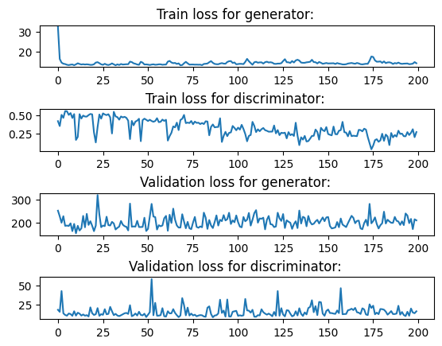
Training and validation results

Slide 9
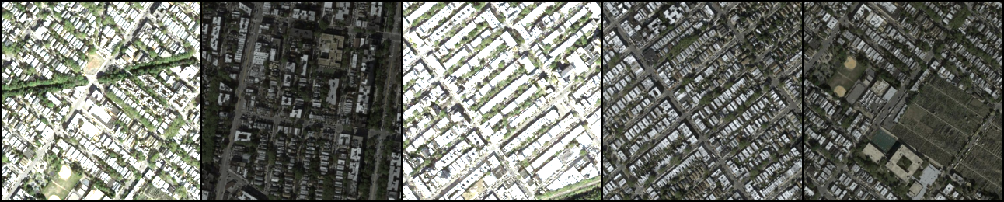
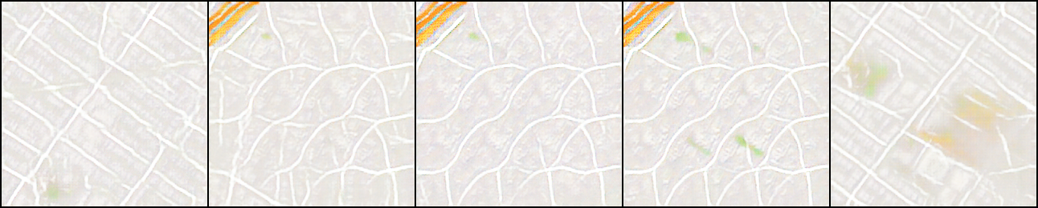
Model Inference

Slide 10
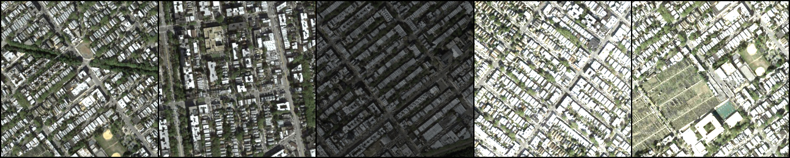
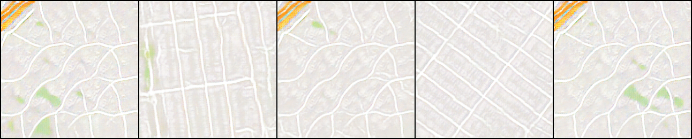
Model Inference

Slide 11

Thank you for your attention!
Presented by: Robert-Alexandru Delicostea

